Slide 1

Social Media Website
Full Stack Project 21002170110063 Vijay CE 17 21002170110169 Dev CE 13 21002170110097 Arth CE 28 21002170510006 Dhruv AIDS 39

Slide 2
Introduction
Instagram clone website is a social media platform that is designed to look and function like Instagram.
We created an Instagram clone website that looks and feels like the real thing.
Also how new posts and Stories are loaded.

Slide 3
Features
Profile page with profile picture, bio, and posts
Main page
Stories
Navigation Menu
Posts
Post By, post time
Post Media
Like, Comments and Shares
Suggestion Box
My Story
Other Stories
Left Navbar
Bottom Navbar
Follow Suggestion

Slide 4
Design
We chose to use a similar color scheme to Instagram's Dark theme.
We used a responsive design that looks great on both desktop and mobile devices.
We made sure to include all the important elements of Instagram's UI such as the navigation bar, and post layout.

Slide 5
Technology Stack
HTML
CSS
Bootstrap
Javascript
APIs Used
Unsplash (Images)
Google Fonts (Icons)

Slide 6
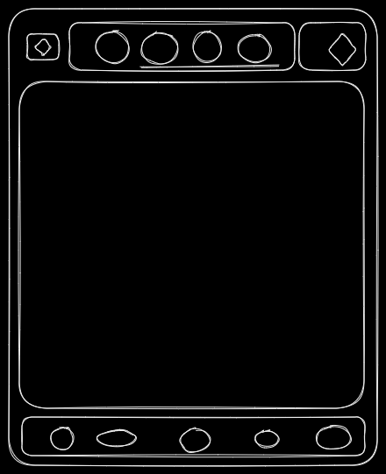
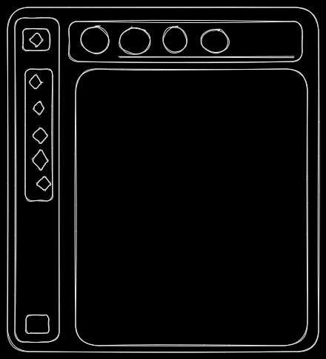
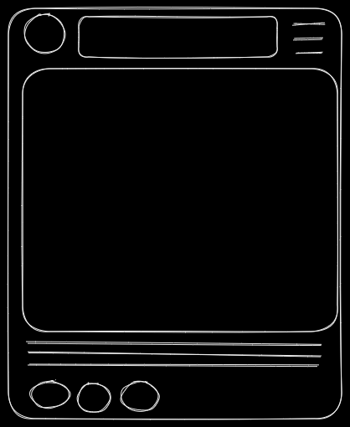
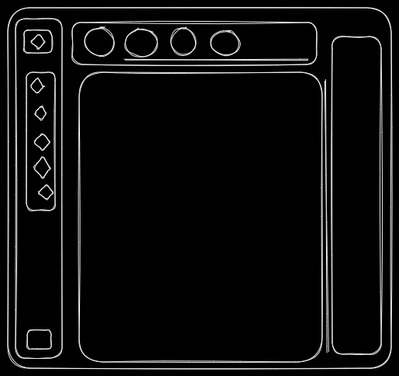
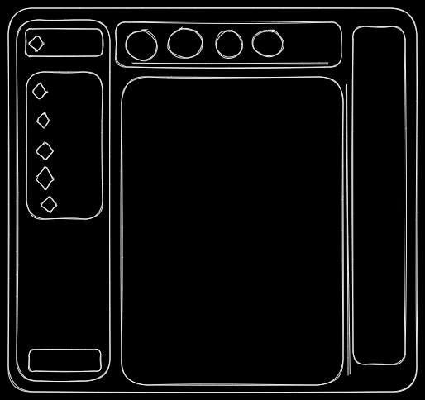
Layouts
Page Layouts
Post Layout
Mobile
Tablet
Small Window
Large Window

Slide 7
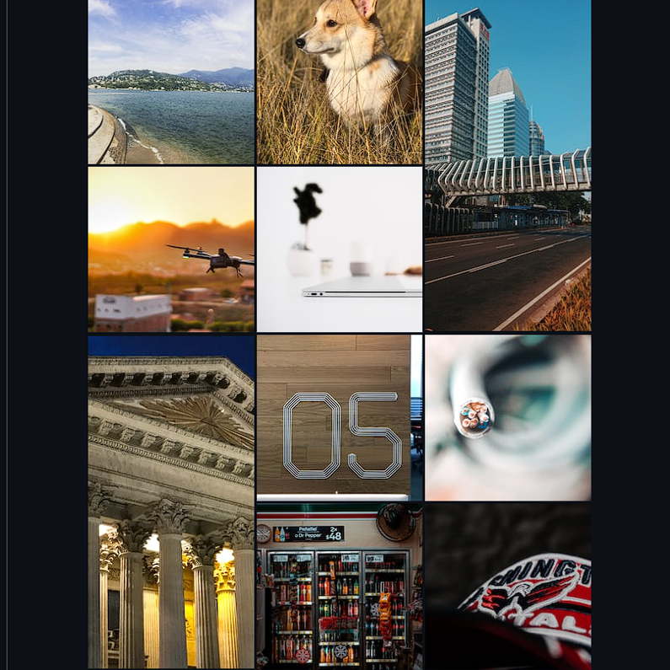
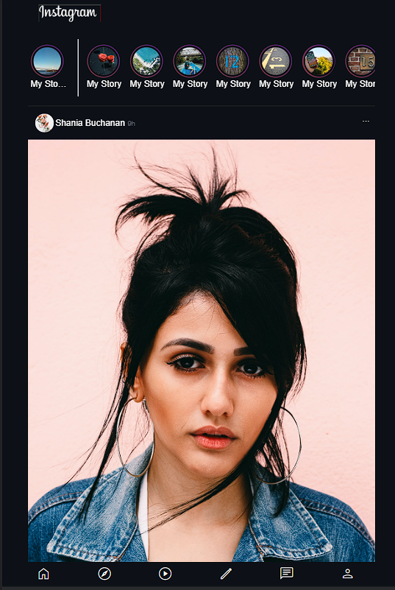
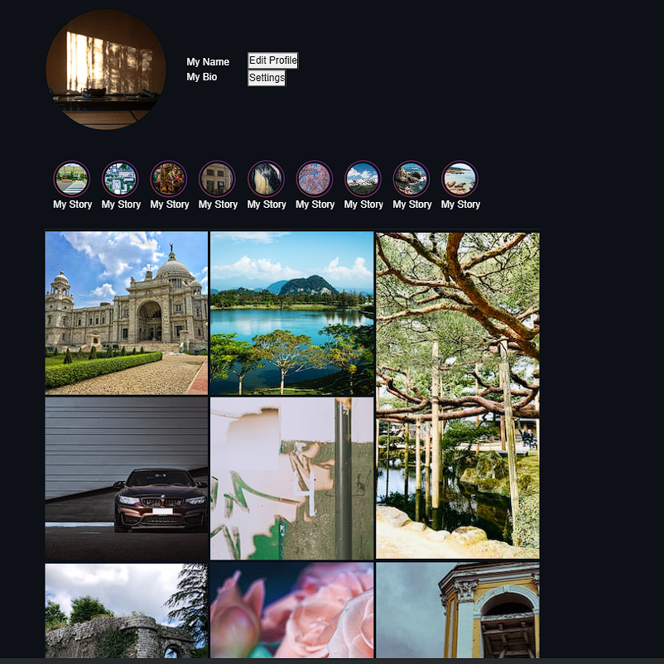
Demo

Slide 8
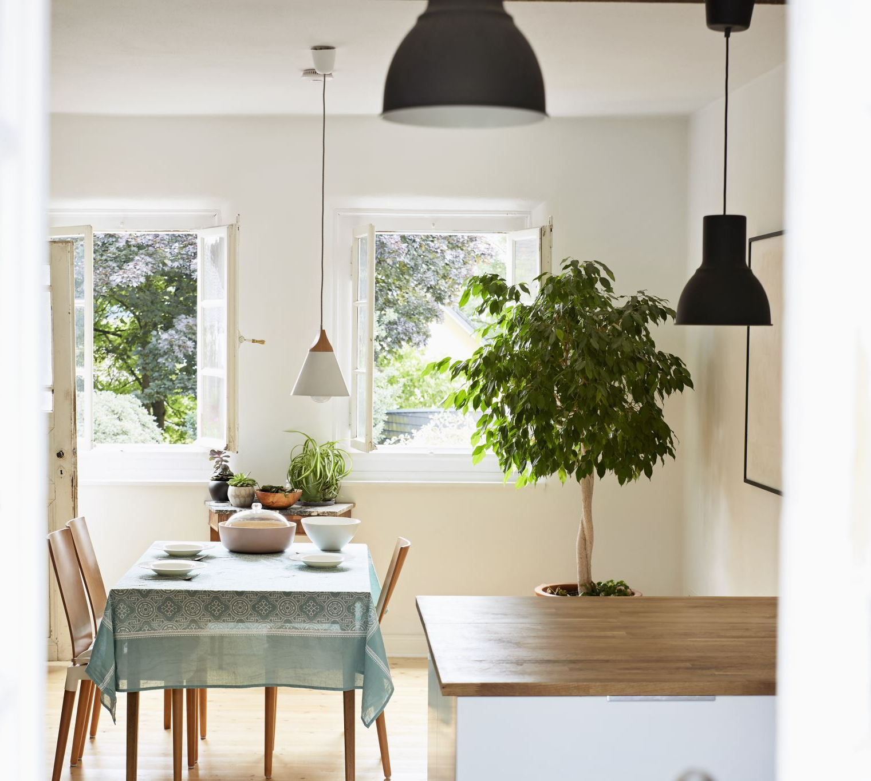
Thank You

